Slide 1

Python Tutorial

Slide 2
Table of contents
What is HAR
Python
Numpy
Panda
Sci Kit Learn
Machine learning

Slide 3

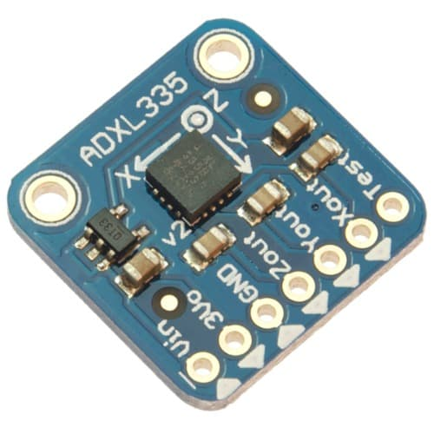
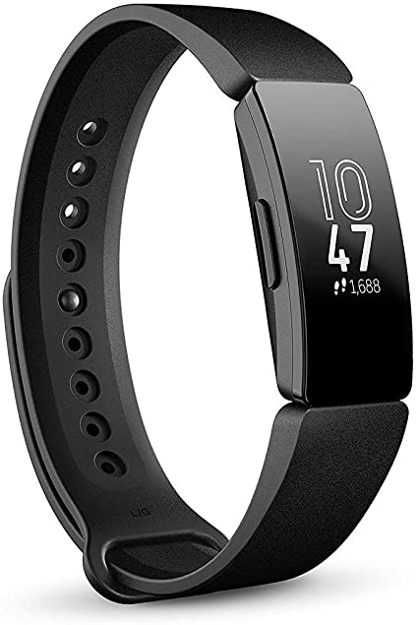
Human Activity Recognition (HAR)
The use of wearable technology to monitor an individual’s daily activities
Notes:
HAR… define it
let’s see some examples
We have iphone… acceleromter
They’re all really different devices but one thing they have in common is that they all collect data

Slide 4
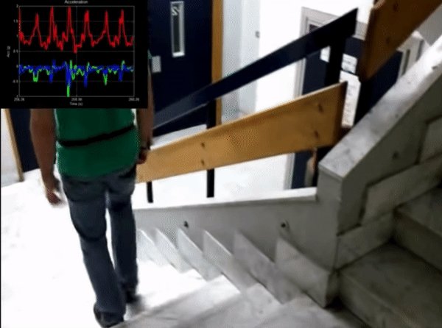
Why HAR
Big data
A lot of pre-processing
Machine learning
Typical data science project
Passive Data

Slide 5
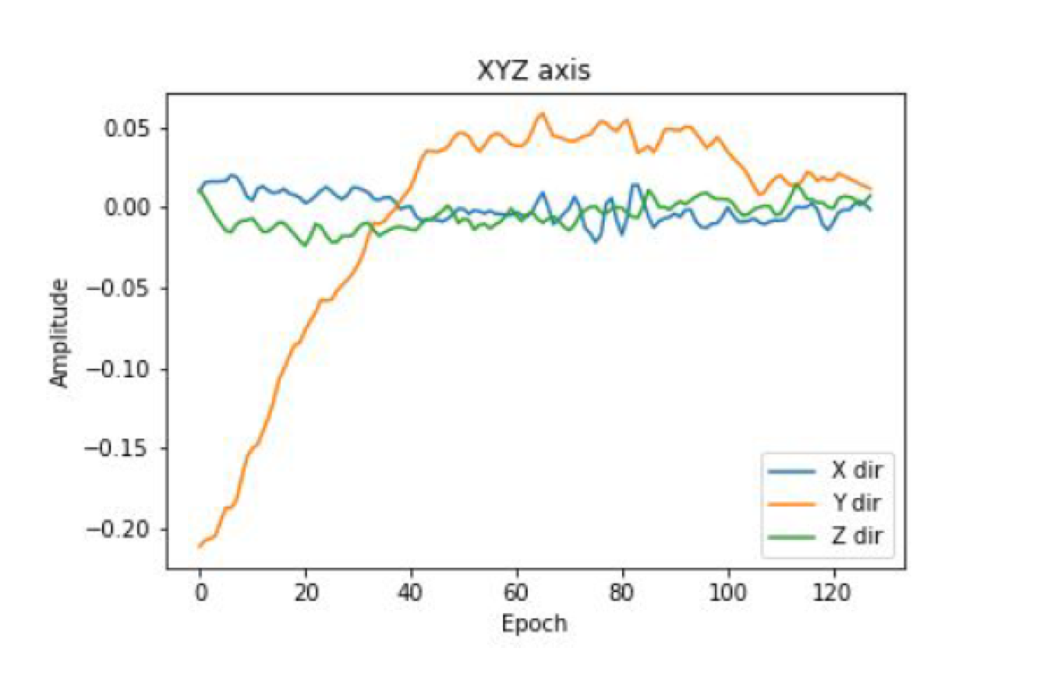
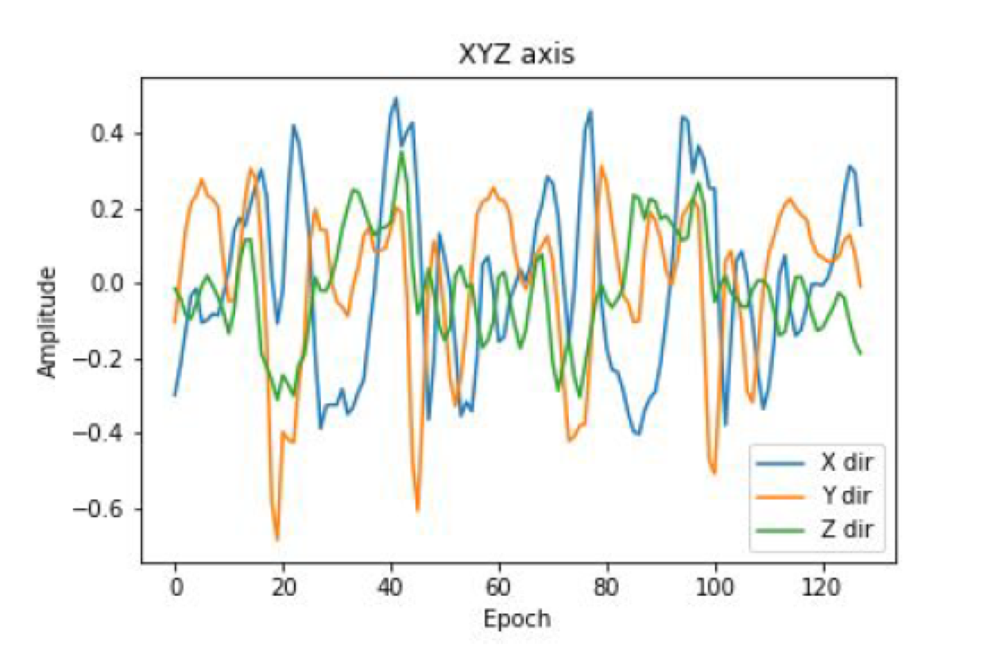
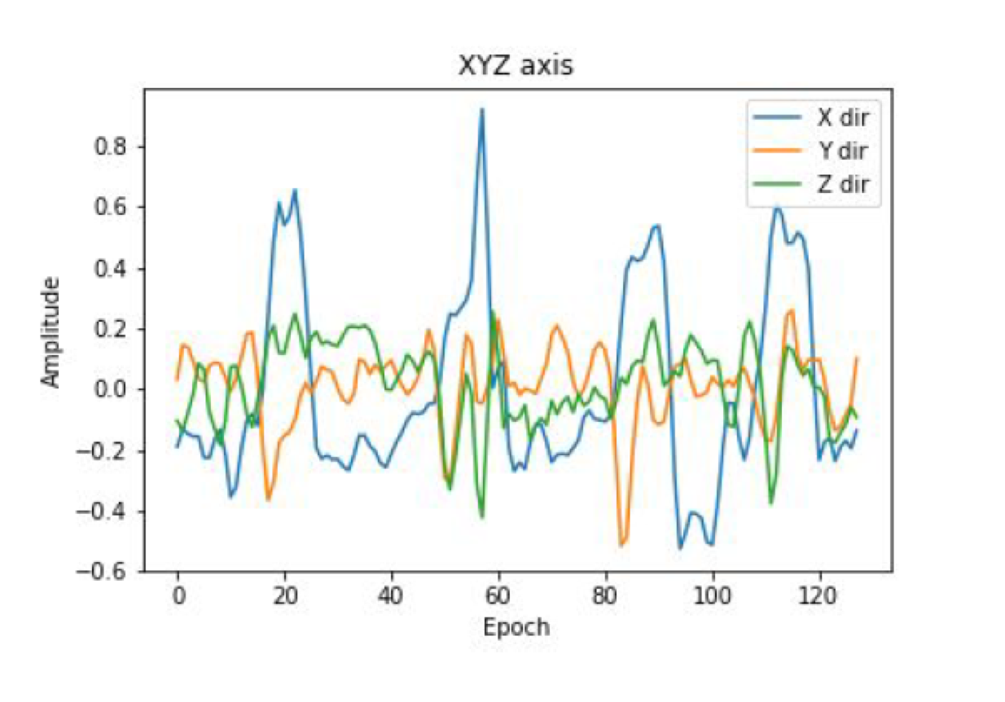
Passive data
Passive sensor is a device that detects and responds to some type of input from the physical environment.
Passively collect data
E.g GPS, accelerometer
Notes:
What is it?

Slide 6
Signal processing, machine learning and deep learning
B. Nguyen, Y. Cohelo, T. Bastos, Krishnan S.. Trends in Human Activity Recognition
with focus on Machine Learning and Power Requirements Special
Issue ”Machine learning and Applications”, submitted, July 2020.
Notes:
How to analyze it

Slide 7
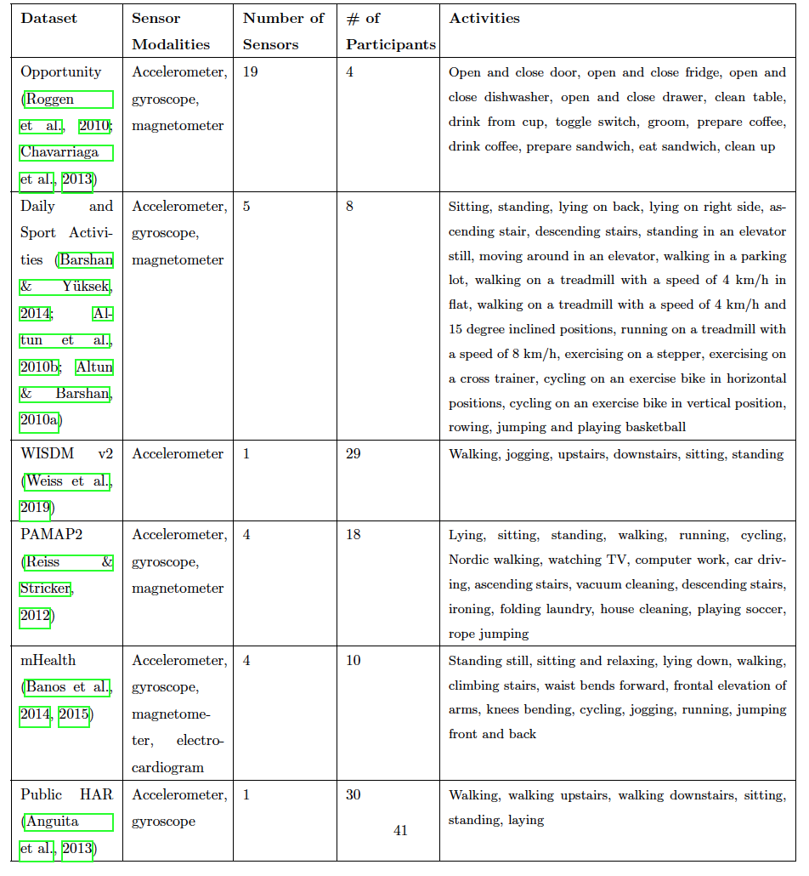
HAR Datasets
B. Nguyen, Y. Cohelo, T. Bastos, Krishnan S.. Trends in Human Activity Recognition
with focus on Machine Learning and Power Requirements Special
Issue ”Machine learning and Applications”, submitted, July 2020.
Notes:
Where to get your hands on this

Slide 8
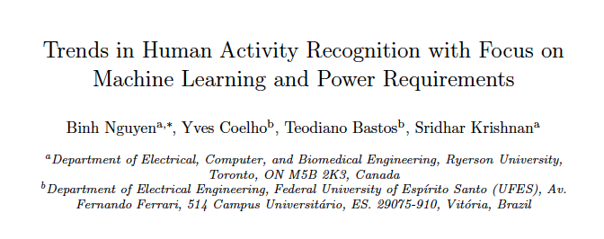
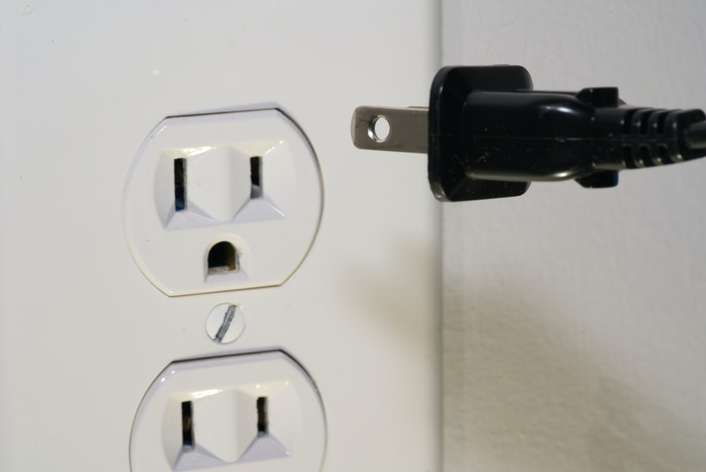
B. Nguyen, Y. Cohelo, T. Bastos, Krishnan S.. Trends in Human Activity Recognition
with focus on Machine Learning and Power Requirements Special
Issue ”Machine learning and Applications”, submitted, July 2020.

Slide 10


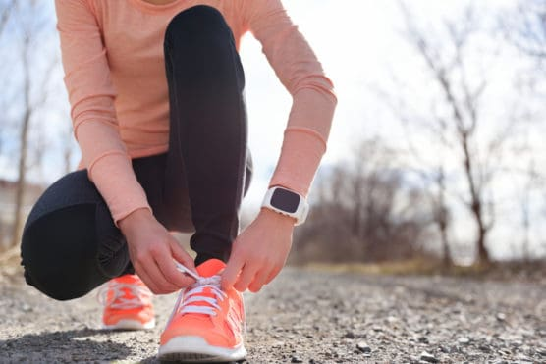

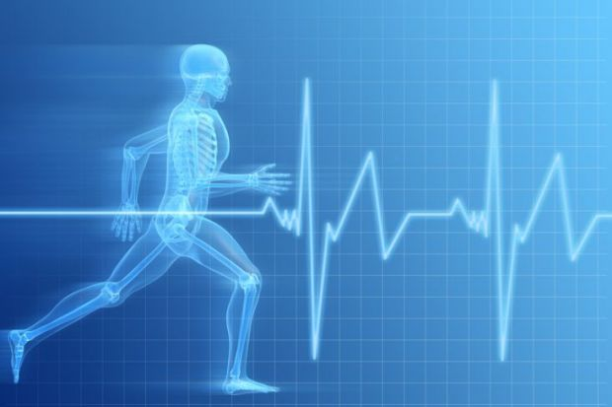
Importance of HAR
HAR can be used as a monitoring system
Sports
Medicine
Consumer health monitoring
COVID-19
Mental health

Slide 11
Python

Slide 12

Numpy

Slide 13
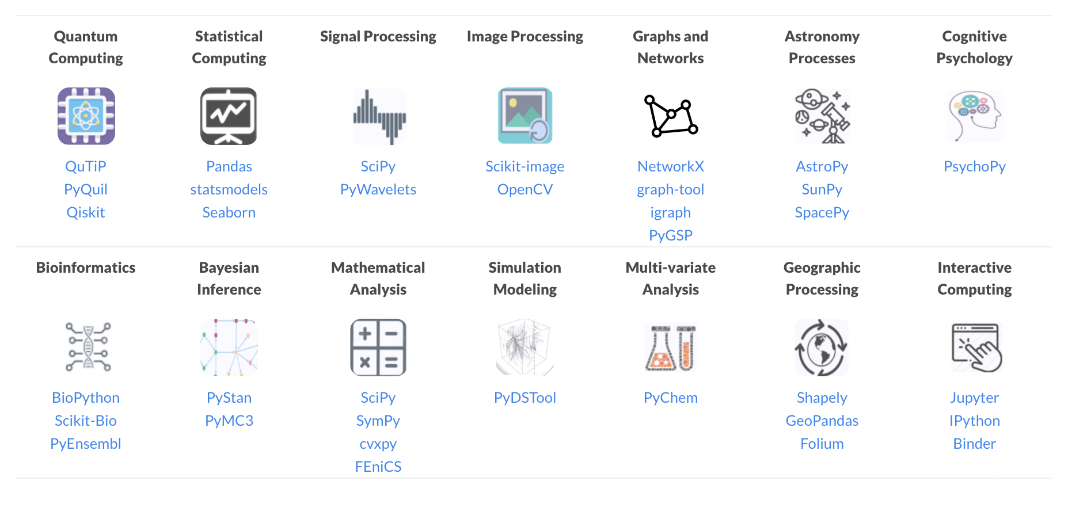

Slide 14
Examples
import numpy as np
Np.sum(x)
Np.mean(x)

Slide 15
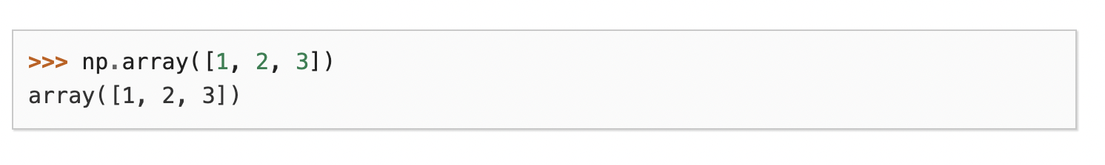
arrays
An array is a container object that holds a fixed number of values of a single type. The length of an array is established when the array is created. After creation, its length is fixed.

Slide 16
Pandas
Dataframe simply represents a table of data with rows and columns. The list of columns and the types in those columns the schema. A simple analogy would be a spreadsheet with named columns

Slide 17


Slide 18
Examples
pd.csv_read()

Slide 19
Sci kit learn
Go-to Machine learning library

Slide 20
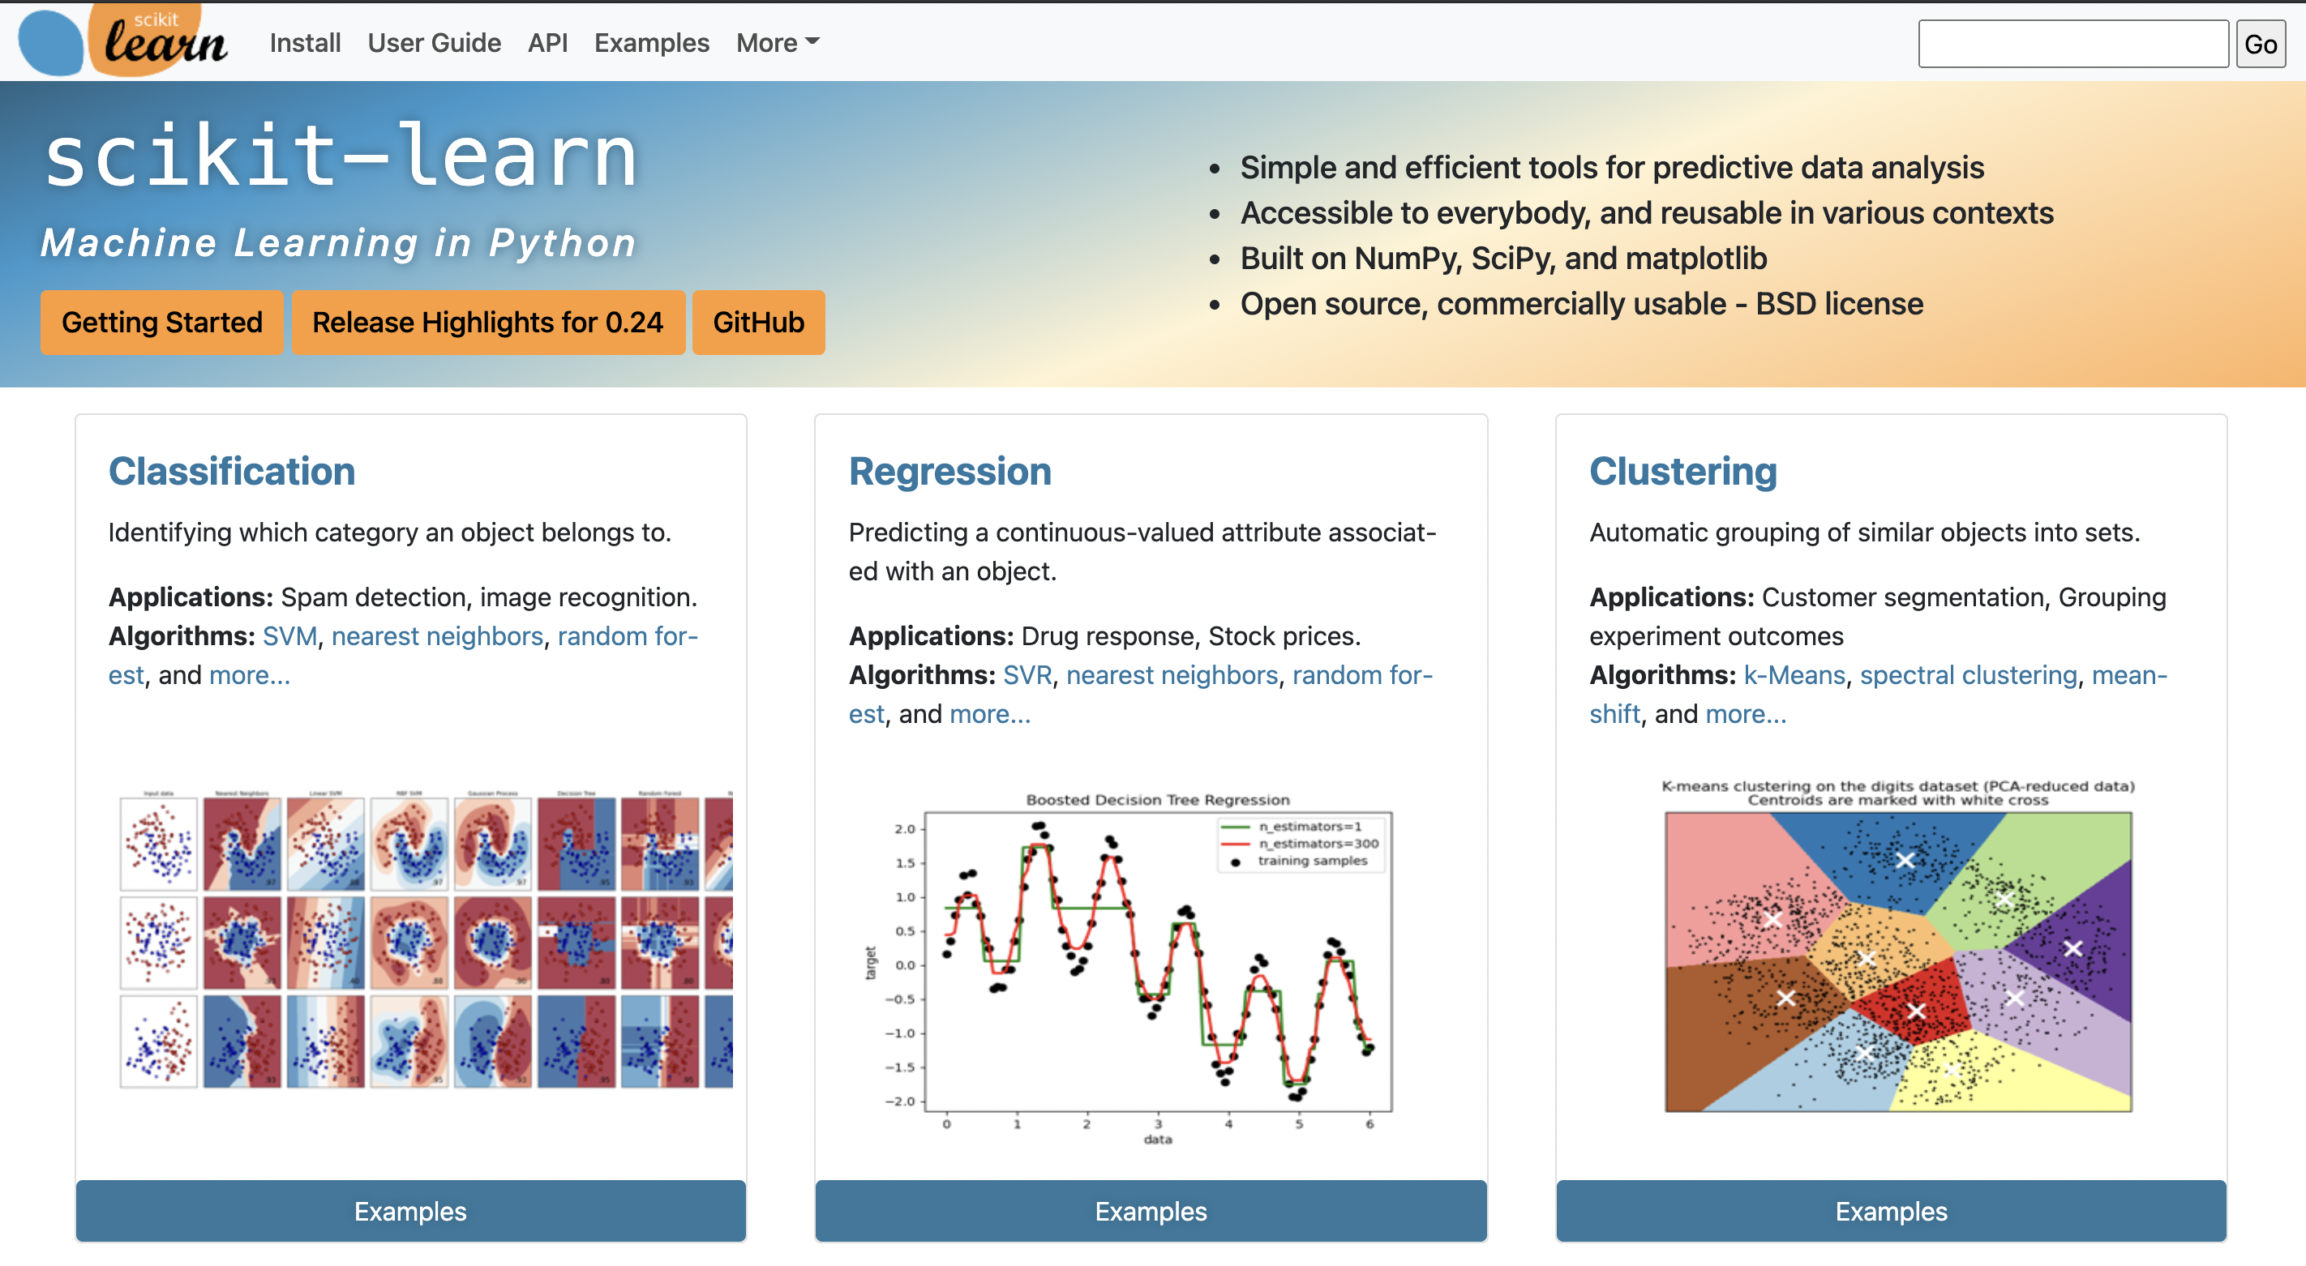

Slide 21
Summary
Numpy
Statistical anaylsis
Mathematical operations
Arrays
Panda
Importing datasets
Sci kit learn
Machine learning

Slide 22
Machine learning
The goal is to use features to create a model and predict other data and give an accuracy based off the test label
Steps
Create a feature set
Train your model
Test your model
Accuracy

Slide 23
Feature set
Extract features from your data
Create a matrix that has
Features as columns
Sample as rows

Slide 24
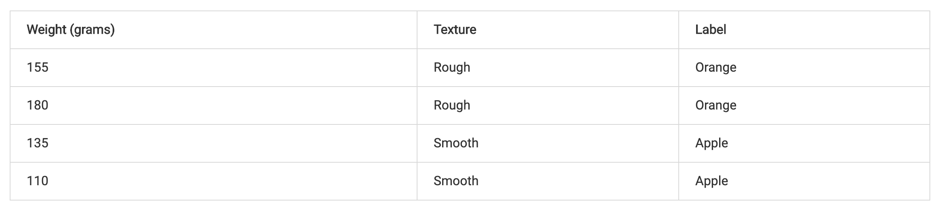
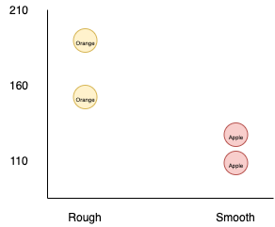
ML Example
Feature 1
Feature 2
Classification

Slide 25
Python
Open folder and explain the dataset
Dataset is of HAR
30 subjects
Activities include stationary, walking, walking upstairs, downstairs, sitting and lying down
Data collected using accelerometer, gyroscope and magnometer
Used windowing, which has 128 samples every window for 2.56 seconds
Dataset is 7352x128
Time spent per action ~= 1 minute … therefore ~= 40 x 2.56
30 x 6 x (~ 40)
# of rows depends on the subject and length of each experiment

Slide 27
Python
2. Jupyter Notebook

